Slide 1
National report
2025 survey

Slide 2
Menu
Visit www.gp-patient.co.uk for further information. Here you can…
1
About the survey
Headline findings
Overall experience of GP practice
Local GP services
Last contact
Patient’s last appointment
Patient health
When the GP practice is closed
Pharmacy
Dentistry
Accessible information
2
3
4
See reports which show the results broken down by ICS, PCN, and GP practice
5
6
7
8
Analyse the survey data for a specific participant group (e.g. by age, ethnicity, those with long-term conditions, and more)
9
10
11

Slide 3
About the survey
Menu:
About the survey
Headline findings
Overall experience of GP practice
Local GP practice services
Last contact
Patient’s last appointment
Patient health
When the GP practice is closed
Pharmacy
Dentistry
Accessible information
1
2
3
4
5
6
7
8
9
10
11
Main menu

Slide 4
About the survey
The GP Patient Survey (GPPS) is an England-wide survey of patients aged 16+.
It provides national, Integrated Care System (ICS), Primary Care Network (PCN) and GP practice-level data about patients’ experiences of primary care services.
Ipsos administers the survey on behalf of NHS England.
This report sets out the national headline and summary findings for the 2025 GPPS survey.
2,721,415 questionnaires were sent out nationally, and 702,837 were returned completed between 30 December 2024 and 1 April 2025. This represents a response rate of 25.8%.
The 2024 survey was the start of a new time series for GPPS. It was therefore important that questionnaire changes were kept to a minimum for the 2025 survey to ensure that results could be compared across 2024 and 2025. However, as in every year, the questionnaire content was reviewed to ensure it reflects the primary care context and priorities. This led to some very minor changes. In addition to the core (online and paper) questionnaire, a small number of additional questions were added to the online version of the survey (vaping behaviour and questions on the NHS Accessible Information Standard). The Technical annex contains more information about these changes.
The 2025 questionnaire and past versions of the questionnaire can be found on the GPPS website.
2.72m
surveys sent to adults registered with a GP practice in England
702,837
completed surveys
25.8%
national response rate
Main menu |

Slide 5
Technical details
A stratified random sample of patients for each GP practice is taken from the national Personal Demographics Service (PDS). All patients aged 16 years or over and registered with the practice for at least 6 months are eligible to be sampled.
As well as the online and paper versions, the questionnaire was available for online completion in British Sign Language and in 14 additional languages as well as over the phone, in large print or Braille.
A weighting scheme has been applied to the data in this report to ensure it is as representative as possible of the GP registered population. Note that a separate weight has been used for the online-only questions to account for the likelihood of a patient responding to the survey online, rather than via the paper questionnaire.
All bases in the report are unweighted. Base sizes differ between questions as not all questions are completed by all patients. In addition, if a patient ticked more than one box when only one response was required or if they answered a question that is not relevant, then those responses are excluded.
Typically, all response options are included in the calculation of a question result. However, for some questions certain response options are excluded from the result where appropriate (e.g., ‘I haven’t tried', ‘I can’t remember', ‘I don’t know'), to provide a more accurate reflection of how those using a service evaluate it.
All percentages are rounded to one decimal place; where combinations of answers do not sum to the percentage reported, or totals do not sum to 100%, this will either be due to rounding or cases where multiple responses are allowed.
For more details please see:
The surveys and reports page on the survey website for the National results and trends and Presentation of results.
The Technical Annex for 2025 for more information about the survey methodology and a data quality statement.
117,499
paper questionnaires completed
585,338
questionnaires completed online
9,899
completed in a language other than English
Main menu |

Slide 6
Headline findings
Menu:
1
About the survey
Headline findings
Overall experience of GP practice
Local GP practice services
Last contact
Patient’s last appointment
Patient health
When the GP practice is closed
Pharmacy
Dentistry
Accessible information
2
3
4
5
6
7
8
9
10
11
Main menu

Slide 7
Headline findings
75.4%
52.9%
69.6%
said their overall experience of their GP practice was good (73.9% in 2024)
said it was easy to contact their GP practice on the phone (49.7% in 2024)
said their overall experience of contacting their GP practice was good (67.3% in 2024)
92.5%
51.2%
11.8%
said they had confidence and trust in the healthcare professional at their last appointment (92.3% in 2024)
said it was easy to contact their GP practice using their practice website (47.9% in 2024)
said their call was answered straight away the last time they contacted their practice (12.3% in 2024)
89.9%
49.0%
72.9%
said their needs were met at their last appointment (89.9% in 2024)
said it was easy to contact their GP practice using the NHS App (44.8% in 2024)
said they knew the next step in dealing with their request within two days of contacting their practice (72.1% in 2024)

Slide 8
Headline findings
57.0%
70.8%
88.0%
reported a good overall experience of NHS services when their GP practice was closed (55.9% in 2024)
reported a good overall experience of NHS dental services (69.2% in 2024)
reported a good experience of using pharmacy services (86.8% in 2024)
44.9%
22.3%
51.2%
phoned NHS 111 when they wanted care or advice from a healthcare professional and their GP practice was closed (46.9% in 2024)
used a pharmacy to get advice (about prescription medicines, health issue or other health services) (20.9% in 2024)
had tried to get an NHS dental appointment in the last two years (52.4% in 2024)
23.4%
8.4%
78.2%
A&E
used A&E when they wanted care or advice from a healthcare professional and their GP practice was closed (24.2% in 2024)
used a pharmacy because they were referred by their GP practice, NHS 111 or A&E (7.3% in 2024)
were able to get an NHS dental appointment, last time they tried (76.3% in 2024)

Slide 9
Overall experience of GP practice
Menu:
1
About the survey
Headline findings
Overall experience of GP practice
Local GP practice services
Last contact
Patient’s last appointment
Patient health
When the GP practice is closed
Pharmacy
Dentistry
Accessible information
3
2
4
5
6
3
8
9
10
11
Main menu

Slide 10
How did patients describe their overall experience of their GP practice?
Three quarters of patients (75.4%) had a good¹ overall experience of their GP practice, with 43.9% describing their experience as ‘very good’. Meanwhile, 11.6% said their experience was poor², with 4.8% describing their experience as ‘very poor’. Another 13.0% of patients said their experience of their GP practice was ‘neither good nor poor’.
There has been a 1.5 percentage point increase in the proportion of patients reporting a good¹ overall experience of their GP practice over the last year (from 73.9% in 2024 to 75.4% in 2025).
Q32. Overall, how would you describe your experience of your GP practice?
¹Good = ‘very good’ and ‘fairly good’. ²Poor = ‘very poor’ and ‘fairly poor’. Base: asked of all patients: 2025 (699,562), 2024 (693,982).
Main menu |

Slide 11
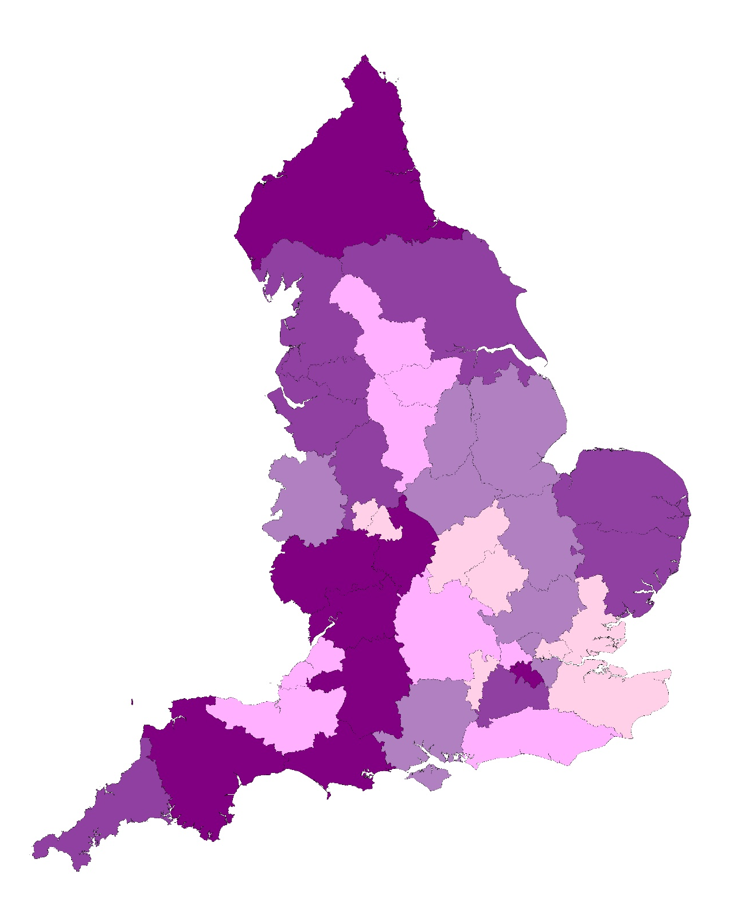
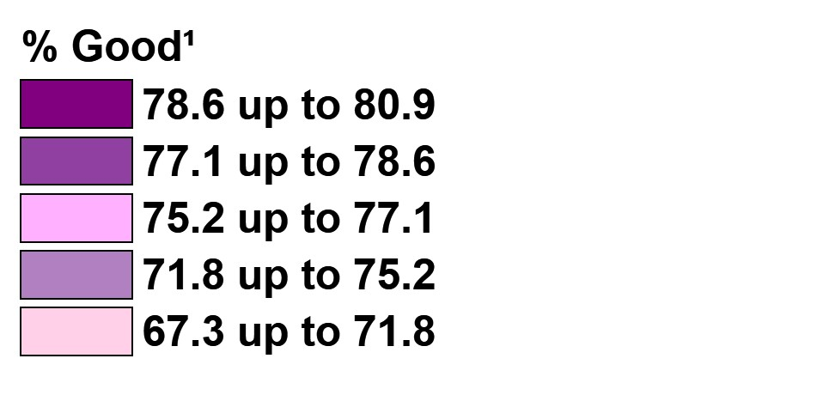
How did overall experience of GP practice vary between Integrated Care Systems (ICSs)?
Overall experience of GP practice
Q32. Overall, how would you describe your experience of your GP practice?
The proportion of patients who reported a good¹ overall experience of their GP practice varied between ICSs (ranging from 67.3% to 80.9%, a difference of 13.6 percentage points).
ICS range - % Good¹
Lowest
67.3%
Highest
80.9%
¹Good = ‘very good’ and ‘fairly good’
ICSs are divided into five equal sized groups based on their results; each group represents 20% of the ICSs. Base: asked of all patients: 2025 (699,562).
Main menu |

Slide 12
How did overall experience of GP practice vary by patient demographics?
Q32. Overall, how would you describe your experience of your GP practice?
% Good²
Patients’ overall experience of their GP practice varied among different patient groups¹.
Which of the following best describes you?
Female patients reported the most positive overall experience.
Non-binary patients or patients who prefer to self-describe reported a less positive overall experience, along with those who would prefer not to say.
Is your gender identity the same as the sex you were registered at birth?
Patients whose gender identity is different from their sex registered at birth reported a less positive overall experience, along with those who would prefer not to say.
Age
Older patients reported a more positive overall experience than younger patients. However, patients who preferred not to say their age, reported a less positive overall experience of their GP practice.
Which of the following best describes you?
Is your gender identity the same as the sex you were registered at birth?
Age
²Good = ‘very good’ and ‘fairly good’. Base: asked of all patients: 2025 (699,562). Base ranges: Which of the following best describes you? (1,010 to 398,800), Gender identity same as sex at birth (3,804 to 684,131), Age (4,958 to 157,416).
To break down the survey results by patient demographics for all other questions, go to https://gp-patient.co.uk/analysistool.
¹Please note that differences in results between different groups of patients may be influenced by other factors.
Main menu |

Slide 13
How did overall experience of GP practice vary by patient demographics?
Q32. Overall, how would you describe your experience of your GP practice?
% Good²
Ethnicity
White
Patients’ overall experience of their GP practice varied by ethnicity¹.
Patients from African or Irish backgrounds reported a more positive overall experience, followed by those from Caribbean and Any other Black, Black British, Caribbean, or African ethnic groups, along with patients from English, Welsh, Scottish, Northern Irish or British backgrounds.
Patients from Gypsy or Irish Traveller backgrounds reported the least positive overall experience, along with those who would prefer not to say.
Mixed or multiple ethnic groups
Asian or Asian British
Black, Black British, Caribbean or African
Other ethnic group
¹Please note that differences in results between different groups of patients may be influenced by other factors.
²Good = ‘very good’ and ‘fairly good’. Base: asked of all patients: 2025 (699,562). Base ranges: Ethnicity (319 to 509,006).
To break down the survey results by patient demographics for all other questions, go to https://gp-patient.co.uk/analysistool.
Main menu |

Slide 14
How did overall experience of GP practice vary by patient demographics?
Q32. Overall, how would you describe your experience of your GP practice?
% Good³
Patients’ overall experience of their GP practice varied among different patient groups¹.
Sexuality
Gay or lesbian and bisexual patients reported a less positive overall experience, along with those who would prefer not to say about their sexuality.
Religion
Christian patients reported a more positive overall experience.
Sikh and Muslim patients reported a less positive overall experience, along with those identifying with other religions and who preferred not to say.
Carer
Patients who are carers², reported a less positive overall experience compared with patients overall.
Sexuality
Religion
Carer
²Carer = Any ‘yes’ at Q61. Do you look after, or give any help or support to, anyone because they have long-term physical or mental health conditions or illnesses, or problems related to old age? ³Good = ‘very good’ and ‘fairly good’. Base: asked of all patients: 2025 (699,562). Base ranges: Sexuality (7,600 to 627,494), Religion (3,717 to 374,590) Carer (124,311).
To break down the survey results by patient demographics for all other questions, go to https://gp-patient.co.uk/analysistool.
¹Please note that differences in results between different groups of patients may be influenced by other factors.
Main menu |

Slide 15
How did overall experience of GP practice vary by patient demographics?
Q32. Overall, how would you describe your experience of your GP practice?
% Good⁴
Patients’ overall experience of their GP practice varied among different patient groups¹.
Deprivation
Patients living in the most deprived areas reported a less positive overall experience.
Disability²
Patients with a disability reported a less positive overall experience compared with patients overall.
Number of long-term conditions³
Patients with three or more conditions reported a less positive overall experience.
IMD deprivation quintiles
Disability
Number of long-term conditions
²Disability = ‘Yes, a lot’ and ‘Yes, a little’ at Q41. Do any of your conditions or illnesses reduce your ability to carry out day-to-day activities? for patients identified as having a long-term condition or illness expected to last 12 months or more. ³Number of long-term conditions = Number of long-term conditions identified at Q39. Which of the following long-term conditions or illnesses do you have? ⁴Good = ‘very good’ and ‘fairly good’. Base: asked of all patients: 2025 (699,562). Base ranges: IMD deprivation quintile (130,703 to 143,781), Disability (272,982) Number of long-term conditions (123,644 to 213,685).
To break down the survey results by patient demographics for all other questions, go to https://gp-patient.co.uk/analysistool.
¹Please note that differences in results between different groups of patients may be influenced by other factors.
Main menu |

Slide 16
Local GP practice services
Menu:
1
About the survey
Headline findings
Overall experience of GP practice
Local GP practice services
Last contact
Patient’s last appointment
Patient health
When the GP practice is closed
Pharmacy
Dentistry
Accessible information
4
2
3
5
6
4
8
9
10
11
Main menu

Slide 17
How easy do patients find contacting their GP practice on the phone?
Overall, 92.7% had tried to contact their GP practice on the phone¹.
Of those who had tried, just over half (52.9%) said it is easy² to contact their GP practice on the phone, with more saying it is ‘fairly easy’ (32.3%) than ‘very easy’ (20.7%). One in three (34.7%) said it is difficult³, including 13.5% who said it is ‘very difficult’.
There has been a 3.2 percentage point increase in the proportion of patients reporting that it is easy² to contact their GP practice on the phone from the 2024 survey (49.7% in 2024 and 52.9% in 2025).
Q1. Generally, how easy or difficult is it to contact your GP practice on the phone?
¹Tried to contact GP practice on the phone = ‘very easy’ and ‘fairly easy’ and ‘neither easy nor difficult’ and ‘fairly difficult’ and ‘very difficult’. ²Easy = ‘very easy’ and ‘fairly easy’. ³Difficult = ‘very difficult’ and ‘fairly difficult’. Base: asked of all patients, excluding those who said ‘I haven’t tried’: 2025 (664,460), 2024 (661,424).
Main menu |

Slide 18
How easy do patients find contacting their GP practice using their website?
Overall, 56.0% had tried to contact their GP practice using their website¹. This is a 4.3 percentage point increase from the 2024 survey (51.7%).
Of those who had tried, around half (51.2%) said it is easy² to contact their GP practice using their website, with 22.8% saying it is ‘very easy’. One third (33.9%) said it is difficult³, including 15.3% who said it is ‘very difficult’.
The proportion of patients reporting that it is easy² to contact their GP practice using their website has increased by 3.3 percentage points from the 2024 survey (47.9% in 2024 and 51.2% in 2025).
Q2. Generally, how easy or difficult is it to contact your GP practice using their website?
¹Tried to contact GP practice using their website = ‘very easy’ and ‘fairly easy’ and ‘neither easy nor difficult’ and ‘fairly difficult’ and ‘very difficult’. ²Easy = ‘very easy’ and ‘fairly easy’. ³Difficult = ‘very difficult’ and ‘fairly difficult’. Base: asked of all patients, excluding those that said ‘I haven’t tried’: 2025 (344,811), 2024 (315,087).
Main menu |

Slide 19
How easy did patients find contacting their GP practice using the NHS App?
Around two in five (42.4%) had tried to contact their GP practice using the NHS App¹, a 6.8 percentage point increase from the 2024 survey (35.6%).
Of those who had tried, just under half (49.0%) said it is easy² to contact their GP practice using the NHS App. Just over one in three (35.5%) said it is difficult, and another 15.5% said it is ‘neither easy nor difficult’.
The proportion of patients reporting that it is easy² to contact their GP practice using the NHS App has increased by 4.2 percentage points from the 2024 survey (44.8% in 2024 and 49.0% in 2025).
Q3. Generally, how easy or difficult is it to contact your GP practice using the NHS App?
¹Tried to contact GP practice using the NHS App = ‘very easy’ and ‘fairly easy’ and ‘neither easy nor difficult’ and ‘fairly difficult’ and ‘very difficult’. ²Easy = ‘very easy’ and ‘fairly easy’. ³Difficult = ‘very difficult’ and ‘fairly difficult’. Base: asked of all patients, excluding those that said ‘I haven’t tried’: 2025 (271,115), 2024 (220,709).
Main menu |

Slide 20
How helpful do patients find the reception and administrative staff at their GP practice?
More than four in five (83.3%) said they find the reception and administrative team at their GP practice helpful¹, including 42.5% who said they find them ‘very helpful’.
Around one in six (16.7%) said they do not find them helpful², including 5.6% who say they find them ‘not at all helpful’.
The proportion of patients reporting they find the reception and administrative team at their GP practice helpful¹ has increased slightly from the 2024 survey (previously 82.6%).
Q4. Overall, how helpful do you find the reception and administrative team at your GP practice?
¹Helpful = ‘very helpful’ and ‘fairly helpful’. ²Not helpful = ‘not very helpful’ and ‘not at all helpful’. Base: asked of all patients, excluding those who said ‘I don’t know’: 2025 (680,531), 2024 (675,643).
Main menu |

Slide 21
Have patients used online GP services in the last 12 months?
Q5. Which of the following online GP services have you used in the last 12 months? (multiple responses allowed)
Overall, three in four (74.4%) reported using at least one online GP service in the 12 months before taking part in the survey¹. This is an increase of 5.4 percentage points from the 2024 survey (69.0%).
Patients most commonly reported booking appointments (45.2%) or ordering repeat prescriptions (42.8%) online.
More than a quarter (28.2%) said they had used online GP services to find out test results.
Just under a quarter (24.2%) had filled in an online form to give information about a health issue.
Slightly fewer (23.4%) reported accessing their medical records, 9.1% had made an administrative request and 3.9% had registered with a practice.
Compared with 2024, all online services were used by a greater proportion, with the most notable increases for finding out test results (+7.1 percentage points), accessing medical records (+6.5 percentage points), filling in an online form (+4.5 percentage points) and booking appointments (+4.2 percentage points).
One in four (25.6%) reported not using any of the online GP services listed in the 12 months before taking part in the survey (a decrease from 2024, previously 31.0%).
¹Used any online general practice service = ‘booking appointments’ or ‘ordering repeat prescriptions’ or ‘finding out test results’ or ‘filling in an online form to give information about a health issue’ or ‘accessing medical records’ or ‘making an administrative request’ or ‘registering with a practice’. Base: asked of all patients: 2025 (696,351), 2024 (692,068).
Main menu |

Slide 22
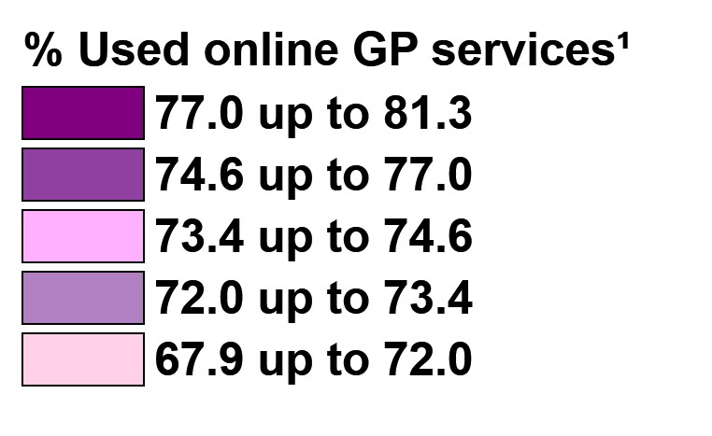
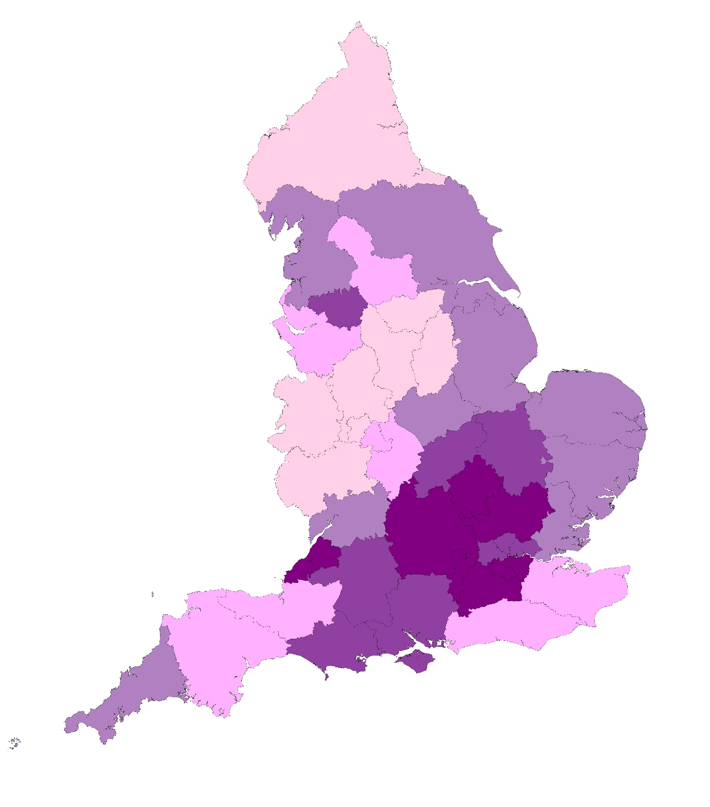
How do use of online GP services vary between Integrated Care Systems (ICSs)?
Have patients used online GP services in the last 12 months?
Q5. Which of the following online GP services have you used in the last 12 months?
The proportion of patients who had used online GP services in the 12 months before taking part in the survey¹ varied between ICSs (ranging from 67.9% to 81.3%, a difference of 13.4 percentage points).
ICS range - % Used any online GP service¹
Lowest
67.9%
Highest
81.3%
¹Used any online general practice service = ‘booking appointments’ or ‘ordering repeat prescriptions’ or ‘finding out test results’ or ‘filling in an online form to give information about a health issue’ or ‘accessing medical records’ or ‘making an administrative request’ or ‘registering with a practice’.
ICSs are divided into five equal sized groups based on their results; each group represents 20% of the ICSs. Base: asked of all patients: 2025 (696,351).
Main menu |

Slide 23
Do patients have a preferred healthcare professional?
How often do patients see their preferred healthcare professional?
Of those who have a preferred healthcare professional at their GP practice, two in five (40.0%) said they get to see or speak to this person always, almost always or a lot of the time¹. Three in five (60.0%) said they get to see or speak to them sometimes, never or almost never².
The proportion of patients who say they get to see their preferred healthcare professional always, almost always or a lot of the time¹ is very similar to the 2024 survey.
Q6. Is there a particular healthcare professional at your GP practice you usually prefer to see or speak to?
Almost a third (32.1%) said there is a particular healthcare professional at their GP practice who they usually prefer to see or speak to. Just over two thirds (67.9%) said they do not have a preferred healthcare professional.
The proportion of patients who had a preferred healthcare professional is similar to the 2024 survey.
Q7. How often do you get to see or speak to your preferred healthcare professional when you ask to?
Had a preferred healthcare professional at their GP practice
Base: asked of all patients: 2025 (695,605), 2024 (690,430)
¹Always, almost always or a lot of the time = ‘Always or almost always’ + ‘a lot of the time’. ² Some of the time or never = ‘Some of the time’ + ‘never or almost never’ Base: asked of all patients who have a healthcare professional they prefer to see or speak to, excluding ‘I haven’t tried’: 2025 (233,882), 2024 (235,538)

Slide 24
Last contact
Menu:
1
About the survey
Headline findings
Overall experience of GP practice
Local GP practice services
Last contact
Patient’s last appointment
Patient health
When the GP practice is closed
Pharmacy
Dentistry
Accessible information
5
2
3
4
6
7
8
9
10
11
Main menu

Slide 25
What was patients’ overall experience of their last contact with their GP practice?
Seven in ten (69.6%) patients had a good¹ overall experience of contacting their GP practice the last time they tried, with 39.1% describing their experience as ‘very good’. Fewer (16.8%) said their overall experience was poor² and 13.6% said it was ‘neither good nor poor’.
The proportion of patients reporting a good¹ overall experience of contacting their GP practice (69.6%) has increased by 2.3 percentage points from the 2024 survey (67.3%).
Q16. Overall, how would you describe your experience of contacting your GP practice on this occasion?
¹Good = ‘very good’ and ‘fairly good’. ²Poor = ‘very poor’ and ‘fairly poor’. Base: asked of patients who have tried to contact their GP practice since being registered: 2025 (686,100), 2024 (680,060).
Main menu |

Slide 26
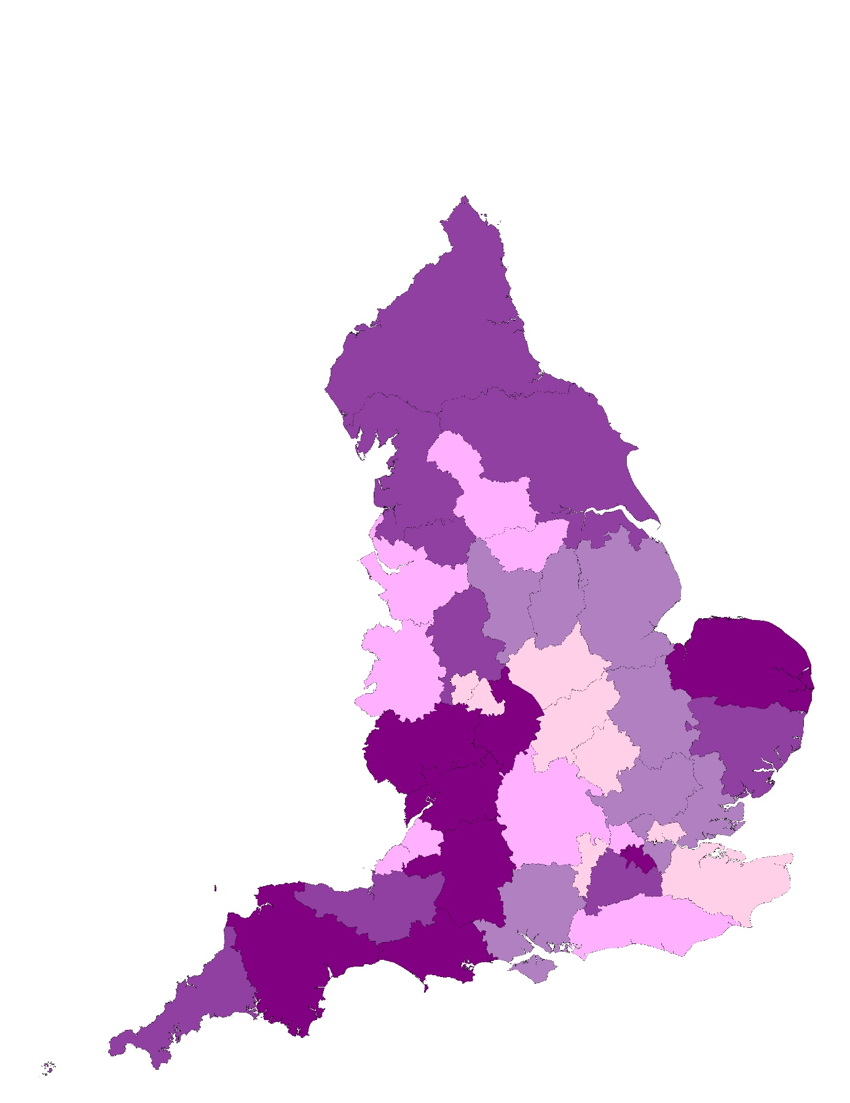
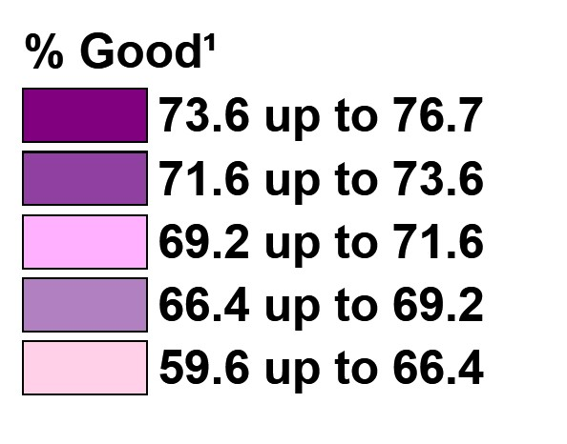
How did overall experience of patients’ last contact with their GP practice vary between Integrated Care Systems (ICSs)?
Overall experience of last contact with GP practice
Q16. Overall, how would you describe your experience of contacting your GP practice on this occasion?
The proportion of patients who described their overall experience of their last contact with their GP practice as good¹ varied between ICSs (ranging from 59.6% to 76.7%, a difference of 17.1 percentage points).
ICS range - % Good¹
Lowest
59.6%
Highest
76.7%
¹Good = ‘very good’ and ‘fairly good’
ICSs are divided into five equal sized groups based on their results; each group represents 20% of the ICSs. Base: asked of patients who have tried to contact their GP practice since being registered: 2025 (686,100).
Main menu |

Slide 27
When did patients last try to contact their GP practice?
Q8. When did you last try to contact your GP practice for yourself or someone else?
Almost two thirds (65.1%) said they last tried to contact their GP practice for themselves or someone else in the 3 months before taking part in the 2025 survey. This is similar to the 2024 survey (65.5%)
Three percent (3.0%) said they had not contacted their GP practice since being registered (2.8% in 2024).
Base: asked of all patients: 2025 (700,602), 2024 (694,979).
Main menu |

Slide 28
What was patients' main reason for trying to contact their GP practice?
Q9. On that occasion, what was your main reason for trying to contact your GP practice?
Overall, almost two thirds (64.6%) said their main reason for trying to contact their GP practice was to get advice or treatment from a healthcare professional for a health issue, this included 39.1% for a new health issue and 25.5% for an existing one.
One in eight (12.3%) contacted their practice because they wanted to get a prescription.
Fewer mentioned other reasons for contacting their practice, but these included: getting test results (5.6%); discussing a referral for specialist care (3.8%), getting help with a fit note or any other medical evidence (2.0%), making an administrative request (1.3%) or registering with the practice as a new patient (0.5%).
One in ten (9.9%) said they contacted their practice because they wanted to do something else.
Base: asked of patients who have tried to contact their GP practice since being registered: 2025 (674,461).
Main menu |

Slide 29
How did patients last try to contact their GP practice?
Q10. Still thinking about the last time you contacted your GP practice, how did you try to contact them?
Among those who tried to contact their GP practice since being registered, three in five (61.8%) said they phoned the practice.
One in seven (14.3%) said they last tried to contact their GP practice by visiting in person, and 14.2% had tried to contact them online, using the practice website.
Fewer tried to contact their GP practice using the NHS App (6.1%) or another website or app (2.1%), and 1.5% said they last tried in another way.
Compared with the 2024 survey, fewer had used the phone to last contact their practice (a 6.0 percentage point decrease), and more had used online methods, including the practice website (+3.1 percentage points) and the NHS App (+2.2 percentage points).
Base: asked of patients who have tried to contact their GP practice since being registered: 2025 (683,277), 2024 (675,534).
Main menu |

Slide 30
Did how the patient contacted their practice influence their overall experience of getting in touch?
Q10. Still thinking about the last time you contacted your GP practice, how did you try to contact them?
Q16. Overall, how would you describe your experience of contacting your GP practice on this occasion?
% Good¹
Overall 69.6% reported a good¹ overall experience of contacting their GP practice the last time they tried. This varied by how patients had tried to contact their practice:
Patients who last contacted their practice online, using the NHS App were most likely to say they had a good overall experience.
Patients who last contacted their practice by phone or online, via a different website or app, or in another way reported the least positive overall experience.
Compared with the 2024 survey, a higher proportion reported a positive experience across all modes of contact (except ‘another way’). While the overall pattern of experience the last time patients contacted their practice was similar by mode, the largest increases were for those who phoned (2.4 percentage points) or used the NHS App (2.1 percentage points).
¹Good = ‘very good’ and ‘fairly good’. Base: asked of patients who have tried to contact their GP practice since being registered: 2025 (672,941) 2024 (681,183). Base range: Type of contact 2025 (9,591 to 449,403), 2024 (8,384 to 478,079).
Main menu |

Slide 31
What happened when patients last contacted their GP practice on the phone?
Q11. What happened when you phoned your GP practice on that occasion?
Among patients who last contacted their GP practice by phone, around one in eight (11.8%) said their call was answered straight away.
In total, 85.2% said their call was held in a queue. This included:
73.1% who waited until someone answered.
10.9% who asked for a call-back through an automated system.
1.2% who did not wait for anyone to answer.
Another 3.0% said that their call was not answered at all.
Compared with the 2024 survey, fewer said their call was held in a queue and they waited until someone answered (-2.3 percentage points) and more asked for a call back through an automated system (+4.2 percentage points). In addition, fewer said their call was not answered (-1.2 percentage points).
Base: asked of patients who last tried to contact their practice by phone: 2025 (448,136), 2024 (476,168).
Main menu |

Slide 32
Were patients able to contact their GP practice the last time they tried?¹
What happened when patients last tried to contact their GP practice?
Overall, 95.9% were able to contact their GP practice last time they tried, just 4.1% could not contact their practice.
% Able to contact their GP practice
95.9%
More than seven in ten (72.9%) said they knew the next step within 2 days, and 5.5% said it took more than two days.
Around one in six (17.5%) said they did not know what the next step would be.
These results are very similar to 2024.
¹This result is based on responses to three questions: ‘Knew next step within 2 days’ = Q13, ‘There and then’ and ‘Later on the same day’ and ‘The next day’; ‘Knew next step after 2 or more days’ = Q13, ‘After two or more days’; ‘Did not know next step’ = Q12, ‘No’ and ‘I was told to contact my practice again another day, as they could not help that day’; ‘Could not contact their GP practice’ = Q11, ‘My call was held in a queue but I didn’t wait for anybody to answer’ and ‘My call wasn’t answered at all’ and Q12, ‘I couldn’t contact my practice’.
Base: all patients who have tried to contact their GP practice since being registered, excluding those who did not provide details of their last contact: 2025 (643,912) 2024 (634,131).
Main menu |

Slide 33
Did patients who managed to contact their practice know the next step?
How soon did patients who managed to contact their GP practice know the next step?
Among those who knew what the next step in dealing with their request would be, 62.8% said they knew ‘there and then’. Another 24.8% knew what the next step would be later on the same day. Five percent (5.3%) knew the next day and 7.1% said it was two or more days before they knew the next step.
Compared with 2024, fewer said they knew the next step ‘there and then’ (-3.1 percentage points) and more said they knew ‘later on the same day’ (+2.6 percentage points).
Of those who managed to contact their practice, over four in five (82.7%) said they knew what the next step would be in dealing with their request.
Q13. How soon after you contacted your GP practice did you know what the next step would be?
Q12. Once you had contacted your GP practice, did you know what the next step in dealing with your request would be?
Base: asked of patients who have tried to contact their GP practice since being registered, except those whose call was not answered, excluding those who said 'I couldn't contact my practice': 2025 (654,818).
Base: asked of patients who knew what the next step in dealing with their request would be, excluding those who said 'I can't remember': 2025 (523,686), 2024 (508,714).
Main menu |

Slide 34
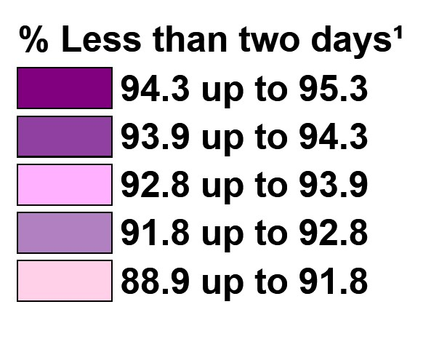
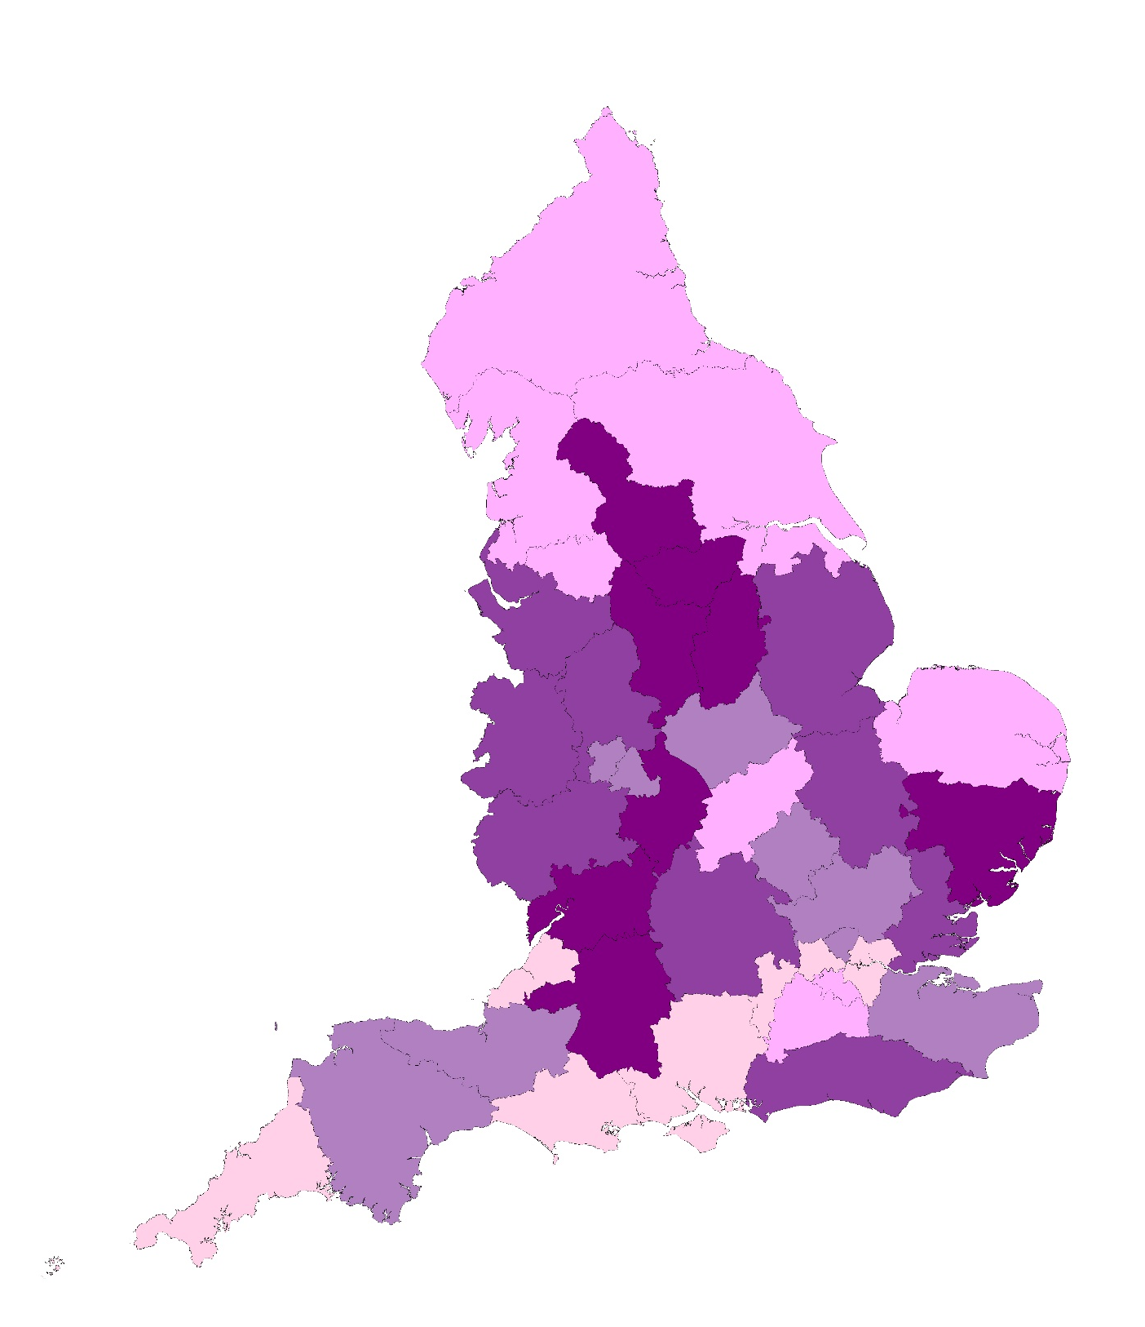
Did the time it took for patients to know the next step vary between ICSs?
Knew next step within two days of contacting their GP practice
Q13. How soon after you contacted your GP practice did you know what the next step would be?
The proportion of patients who managed to contact their practice and knew the next step in less than two days¹ varied between ICSs (ranging from 88.9% to 95.3%, a difference of 6.5 percentage points).
ICS range - % Less than two days¹
Lowest
88.9%
Highest
95.3%
¹Less than two days = ‘there and then’ and ‘later on the same day’ and ‘the next day’
ICSs are divided into five equal sized groups based on their results; each group represents 20% of the ICSs. Base: asked of patients who knew what the next step in dealing with their request would be, excluding those who said ‘I can’t remember’: 2025 (523,686).
Main menu |

Slide 35
If patients could not contact their GP practice, or did not know what the next step was, what did they do?
Q15. What did you do when you couldn’t contact your GP practice or didn’t know what the next step would be?
Patients who could not contact their GP practice or did not know the next step
21.6% of patients could not contact their GP practice or did not know what the next step would be. Of these patients:
More than half (51.2%) said they tried to contact their GP practice again.
Around one in ten said they had looked for information online (11.9%), tried to treat themselves or the person they were contacting the practice for (11.6%), tried to get information or advice from somewhere else (11.1%), went to a pharmacy (10.9%) or phoned NHS 111 (9.9%).
17.3% said did not do anything when they could not contact their GP practice or did not know what the next step would be.
All patients
The chart also shows the proportion of all patients responding to the survey who took these actions. For example, 3.3% of those taking part said they couldn’t contact their practice or didn’t know the next step and then did not end up doing anything.
¹Base: asked of patients who couldn't contact their practice or didn't know what the next step in dealing with their request would be: 2025 (117,044). ²Base: all patients completing a questionnaire: 2025 (702,837).
Main menu |

Slide 36
Patient’s last appointment
Menu:
1
About the survey
Headline findings
Overall experience of GP practice
Local GP practice services
Last contact
Patient’s last appointment
Patient health
When the GP practice is closed
Pharmacy
Dentistry
Accessible information
6
2
3
4
5
7
8
9
Note that a patient’s last appointment may have happened at any time since being registered with their GP practice.
10
11
Main menu

Slide 37
When did patients last have a GP practice appointment?
Q17. When was your last GP practice appointment?
Seven in ten (70.2%) had their last general practice appointment in the 6 months before taking part in the survey¹, including 51.2% who had their last general practice appointment in the last 3 months.
Just over two in five (25.9%) had their last appointment over 6 months ago², and 3.8% had not had an appointment since registering with their GP practice.
These results are all very similar to the 2024 survey.
¹In the last 6 months = ‘in the last 3 months’ or ‘between 3 and 6 months ago’. ²More than 6 months ago = ‘between 6 and 12 months ago’ or ‘more than 12 months ago’,
Base: asked of all patients: 2025 (700,204), 2024 (694,342).
Main menu |

Slide 38
What actions were taken before trying to get an appointment?
Q18. Did you do any of the following before trying to get an appointment with your GP practice? (multiple responses allowed)
Patients reported taking a variety of actions before trying to get an appointment at their GP practice.
Overall, 61.8% had tried to do something else before trying to get an appointment¹. Specifically:
Just over a third (35.3%) tried to treat themselves.
28.5% said they looked online for information.
15.3% asked a friend or family member for advice and 15.0% went to a pharmacy.
4.4% phoned NHS 111, 3.0% used NHS 111 online, and 2.6% tried a different NHS service.
One in ten (10.1%) tried to get information or advice from somewhere else.
Two in five (38.2%) did not do anything before trying to get an appointment with their GP practice.
These findings are broadly similar to the 2024 survey, with a slight increase in the proportion who tried to treat themselves and decrease in the proportion who did not do anything.
¹Tried to do something else = Gave at least one answer to Q18, except 'I didn't do anything before trying to get an appointment with my GP practice’. Base: asked of patients who had an appointment since being registered with current GP practice: 2025 (676,856), 2024 (668,709).
Main menu |

Slide 39
Were patients offered a choice of appointment?
Q19. Were you offered the following choices? (multiple responses allowed)
Patients were asked if they were offered a choice of either time or location at their last GP practice appointment.
Over half (54.2%) said they were offered a choice of time or day.
Around one in seven (14.3%) said they were offered a choice of location (to see a healthcare professional in person).
Slightly more said they were offered both types of choice compared with the 2024 survey (both time or day and location increased by 1.4 percentage points).
Just under two in five (39.4%) were not offered either of these choices, a decrease from the 2024 survey (previously 41.2%).
Base: asked of patients who had an appointment since being registered with current GP practice, excluding those who said 'I didn't need a choice' or 'I can't remember': 2025 (492,908), 2024 (485,104).
Main menu |

Slide 40
How long after patients first contacted their GP practice did the appointment take place?
Q20. How long after you first contacted your GP practice did the appointment take place?
Just over a third (35.1%) had their last appointment on the same or next day after first contacting their GP practice, including 27.5% on the same day and 7.6% the next day.
Just over one in five (21.8%) had the appointment a few days later, and slightly fewer (20.6%) said it was between a week and two weeks later.
One in eight (12.6%) said their appointment was more than two weeks after first contacting their GP practice.
These results are all very similar to the 2024 survey.
Base: asked of patients who had an appointment since being registered with current GP practice: 2025 (679,970), 2024 (670,580).
Main menu |

Slide 41
How did patients feel about how long they waited for an appointment?
Q21. How do you feel about how long you waited for your appointment?
Over two thirds (67.2%) said the length of time they waited for their appointment was about right.
Around one third (32.8%) said it took too long to get the appointment.
Compared with the 2024 survey, a slightly higher proportion said that they waited about the right amount of time and fewer said it took too long.
Base: asked of patients who had an appointment since being registered with current GP practice, excluding those who said 'I don't know': 2025 (620,168), 2024 (610,869).
Main menu |

Slide 42
How did the last appointment take place?
Q22. How did the appointment take place?
For their last appointment, just over two thirds (67.0%) said they saw someone at their GP practice and one in four (25.2%) spoke to someone over the phone.
Fewer patients saw someone at another general practice location (4.9%), at their home (0.4%) or over a video call (0.3%).
Small proportions had the appointment by text message (1.2%) or online message (1.1%).
Compared with 2024, a higher proportion saw someone at their GP practice (+3.0 percentage points) and a lower proportion said their last appointment was over the phone (-3.7 percentage points).
¹Note that this appointment could have occurred at any time since being registered at their GP.
Base: asked of patients who had an appointment since being registered with current GP practice: 2025 (677,815), 2024 (666,169).
Main menu |

Slide 43
Who did patients have their last general practice appointment with?
Q23. Who did you have the appointment with?
Over three in five (63.5%) said their last appointment was with a GP, and over one in five (22.2%) said it was with a nurse.
Seven percent (6.9%) said they had their last appointment with another healthcare professional. Smaller proportions of patients said their last appointment was with a general practice pharmacist (1.7%) or a mental health professional (0.7%).
In addition, 5.1% said they did not know who they saw at their last appointment.
Compared with 2024, there has been a slight decrease in the proportion who said their last appointment was with a GP (-1.3 percentage points).
Base: asked of patients who had an appointment since being registered with current GP practice: 2025 (676,652), 2024 (666,147).
Main menu |

Slide 44
Did the type of appointment influence whether patient needs were met?
Q22. How did the appointment take place?
Q31. Thinking about the reason for your last appointment, were your needs met?
% Yes, needs met²
Overall 89.9% reported that their needs were met at their last appointment².
A higher proportion of patients said their needs were met¹ if the appointment was in person, including seeing someone at their GP practice (92.2%), at their home (91.9%) or at a different general practice location (86.8%).
Lower proportions of patients whose last appointment was remote said their needs were met¹, including speaking to someone over the phone (86.2%), over a video call (81.1%), by online message (74.9%) or text message (73.5%).
Overall this pattern is very similar to that found in 2024, but there has been a slight increase in the proportions saying their needs were met among those having remote appointments (by phone, online and text message) compared with face-to-face. Video calls are an exception to this, with a lower proportion saying their needs were met.
¹Please note that differences in results between different appointment types may be influenced by other factors.
²Yes, needs met = ‘yes, definitely and ‘yes, to some extent’. Base: asked of patients who had an appointment since being registered with current GP practice, excluding those who said ‘I don’t know’ whether their needs were met: 2025 (661,794) 2024 (649,183). Base range: Type of appointment (1,105 to 450,105).
Main menu |

Slide 45
How did patients rate the healthcare professional at listening to them?
More than four in five (86.9%) said that the healthcare professional was good¹ at listening to them during their last appointment, including 62.2% who said they were ‘very good’. Six percent (5.8%) said the healthcare professional was poor² at listening to them.
These results are in line with the 2024 survey findings.
Q24. During your last appointment, how good was the healthcare professional at listening to you?
¹Good = ‘very good’ and ‘fairly good’. ²Poor = ‘very poor’ and ‘fairly poor’. Base: asked of patients who had an appointment since being registered with current GP practice, excluding those who said 'I don't know or it didn't apply': 2025 (671,414), 2024 (661,822).
Main menu |

Slide 46
How did patients rate the healthcare professional at treating them with care and concern?
More than four in five (85.6%) said that the healthcare professional was good¹ at treating them with care and concern during their last appointment, including 60.9% who said they were ‘very good’. Six per cent (6.2%) said the healthcare professional was poor² at treating them with care and concern.
These results are in line with the 2024 survey findings.
Q25. During your last appointment, how good was the healthcare professional at treating you with care and concern?
¹Good = ‘very good’ and ‘fairly good’. ²Poor = ‘very poor’ and ‘fairly poor’. Base: asked of patients who had an appointment since being registered with current GP practice, excluding those who said 'I don't know or it didn't apply': 2025 (670,865), 2024 (661,177).
Main menu |

Slide 47
How did patients rate the healthcare professional at considering their mental wellbeing?
Nearly three in four (73.6%) said that the healthcare professional was good¹ at considering their mental wellbeing during their last appointment, including over half (51.1%) who said they were ‘very good’. Just under one in ten (8.5%) said they were poor² at considering their mental wellbeing, and 17.9% said they were ‘neither good nor poor’.
These results are in line with the 2024 survey findings.
Q26. During your last appointment, how good was the healthcare professional at considering your mental wellbeing?
¹Good = ‘very good’ and ‘fairly good’. ²Poor = ‘very poor’ and ‘fairly poor’. Base: asked of patients who had an appointment since being registered with current GP practice, excluding those who said 'I don't know or it didn't apply': 2025 (514,139), 2024 (504,435).
Main menu |

Slide 48
Did patients feel the healthcare professional had all the information they needed about them?
Over nine in ten (91.9%) said they felt the healthcare professional had all the information they needed about them¹ during their last appointment. This included nearly three in five (57.4%) who said this was ‘definitely’ the case. Eight percent (8.1%) said the healthcare professional did not have all the information they needed.
These results are in line with the 2024 survey findings.
Q27. Did you feel that the healthcare professional had all the information they needed about you?
¹Yes = ‘yes, definitely’ and ‘yes, to some extent’. ²No = ‘No, not at all’. Base: asked of patients who had an appointment since being registered with current GP practice, excluding those who said 'I don't know or it didn't apply': 2025 (650,445), 2024 (640,016).
Main menu |

Slide 49
Did patients have confidence and trust in who they saw or spoke to?
Over nine in ten patients (92.5%) had confidence and trust¹ in the healthcare professional they saw or spoke to at their last appointment. This includes 63.6% who said they ‘definitely’ had confidence and trust in them. Eight percent (7.5%) did not have confidence and trust in the healthcare professional at their last appointment.
These results are in line with the 2024 survey findings.
Q28. Did you have confidence and trust in the healthcare professional you saw or spoke to?
¹Yes = ‘yes, definitely’ and ‘yes, to some extent’. ²No = ‘No, not at all’. Base: asked of patients who had an appointment since being registered with current GP practice, excluding those who said 'I don't know or it didn't apply': 2025 (665,885), 2024 (656,379).
Main menu |

Slide 50
Did patients feel involved in decisions about their care and treatment?
Just over nine in ten (91.2%) patients felt that during their last appointment they were involved as much they wanted to be in decisions about their care and treatment¹, including three in five (61.6%) who said they ‘definitely’ felt involved. Nine percent (8.8%) said they were ‘not at all’ involved in decisions about their care and treatment.
These results are in line with the 2024 survey findings.
Q29. At your last appointment, were you involved as much as you wanted to be in decisions about your care and treatment?
¹Yes = ‘yes, definitely’ and ‘yes, to some extent’. ²No = ‘No, not at all’. Base: asked of patients who had an appointment since being registered with current GP practice, excluding those who said ‘I can't remember or it didn't apply': 2025 (635,043), 2024 (624,643).
Main menu |

Slide 51
What was the outcome of patients’ last appointment?
Q30. What was the outcome of the appointment on this occasion? (multiple responses allowed)
Following their last general practice appointment, the most likely outcome was that patients were given a prescription (39.9%).
Just over one in five were referred for specialist care (22.0%) or were given information about how to manage the condition at home (21.0%). Slightly fewer (17.3%) were advised to contact their practice again if the health issue got worse or did not improve.
Almost one in ten were given a future appointment at their GP practice (9.3%) or said that no further action was needed (9.9%). Another 3.0% were asked for more information.
One in eight (12.2%) said that something else happened.
These results are all very similar to the 2024 survey.
Base: asked of patients who had an appointment since being registered with current GP practice: 2025 (679,328), 2024 (670,156).
Main menu |

Slide 52
Were patients' needs met at their last appointment?
Nine in ten (89.9%) patients felt that their needs were met¹ during their last appointment, with 57.2% saying they were ‘definitely’ met. One in ten (10.1%) patients felt that their needs were ‘not met at all’.
These results are in line with the 2024 survey findings.
Q31. Thinking about the reason for your last appointment, were your needs met?
¹Yes = ‘yes, definitely’ and ‘yes, to some extent’. ²No = ‘No, not at all’. Base: asked of patients who had an appointment since being registered with current GP practice, excluding those who said ‘I don’t know': 2025 (666,889), 2024 (657,398).
Main menu |

Slide 53
How did needs being met vary by patient demographics?
Q31. Thinking about the reason for your last appointment, were your needs met?
% Yes²
Whether patient needs were met at their last appointment varied among different patient groups¹.
Which of the following best describes you?
Female patients were slightly more likely to have said their needs were met.
Non-binary patients or patients who prefer to self-describe were less likely to have said their needs were met, along with those who would prefer not to say.
Is your gender identity the same as the sex you were registered at birth?
Patients whose gender identity is different from their sex registered at birth were less likely to have said their needs were met, along with those who would prefer not to say.
Age
Older patients were more likely to have said their needs were met than younger patients. However, patients who preferred not to say their age, were less likely to say their needs were met.
Which of the following best describes you?
Is your gender identity the same as the sex you were registered at birth?
Age
²Yes = ‘yes, definitely’ and ‘yes, to some extent’. Base: asked of patients who had an appointment since being registered with current GP practice, excluding those who said ‘I don’t know': 2025 (666,889). Base ranges: Which of the following best describes you? (862 to 384,123), Gender identity same as sex at birth (3,264 to 654,127), Age (4,161 to 152,148).
To break down the survey results by patient demographics for all other questions, go to https://gp-patient.co.uk/analysistool.
¹Please note that differences in results between different groups of patients may be influenced by other factors.
Main menu |

Slide 54
How did needs being met vary by patient demographics?
Q31. Thinking about the reason for your last appointment, were your needs met?
% Yes²
Ethnicity
Whether patient needs were met at their last appointment varied among different patient groups¹.
Patients from Irish and English, Welsh, Scottish, Northern Irish or British ethnic groups were most likely to have said their needs were met, along with those from Chinese, Caribbean and African backgrounds.
Patients from Gypsy or Irish Traveller and Roma backgrounds were least likely to have said their needs were met.
White
Mixed or multiple ethnic groups
Asian or Asian British
Black, Black British, Caribbean or African
Other ethnic group
²Yes = ‘yes, definitely’ and ‘yes, to some extent’. Base: asked of patients who had an appointment since being registered with current GP practice, excluding those who said ‘I don’t know': 2025 (666,889). Base ranges: Ethnicity (301 to 492,474).
To break down the survey results by patient demographics for all other questions, go to https://gp-patient.co.uk/analysistool.
¹Please note that differences in results between different groups of patients may be influenced by other factors.
Main menu |

Slide 55
How did needs being met vary by patient demographics?
Q31. Thinking about the reason for your last appointment, were your needs met?
% Yes³
Whether patient needs were met at their last appointment varied among different patient groups¹.
Sexuality
Bisexual and gay or lesbian patients were less likely to have said their needs were met, along with those who described their sexuality in another way or preferred not to say.
Religion
Christian patients were more likely to have said their needs were met.
Muslim patients were less likely to have said their needs were met, along with those identifying with another religion and who preferred not to say.
Carer²
Patients who are carers were less likely to have said their needs were met compared with patients overall.
Sexuality
Religion
Carer
²Carer = Any ‘yes’ at Q61. Do you look after, or give any help or support to, anyone because they have long-term physical or mental health conditions or illnesses, or problems related to old age? ³Yes = ‘yes, definitely’ and ‘yes, to some extent’. Base: asked of patients who had an appointment since being registered with current GP practice, excluding those who said ‘I don’t know': 2025 (666,889). Base ranges: Sexuality (6,750 to 602,670), Religion (3,558 to 360,606), Carer (120,142).
To break down the survey results by patient demographics for all other questions, go to https://gp-patient.co.uk/analysistool.
¹Please note that differences in results between different groups of patients may be influenced by other factors.
Main menu |

Slide 56
How did needs being met vary by patient demographics?
Q31. Thinking about the reason for your last appointment, were your needs met?
% Yes⁴
Whether patient needs were met at their last appointment varied among different patient groups¹.
Deprivation
As deprivation increased, the proportion of patients reporting that their needs were met decreased, with patients living in the most deprived areas the least likely to have said their needs were met.
Disability²
Patients with a disability were less likely to have said their needs were met compared with patients overall.
Number of long-term conditions³
Patients with three or more long-term conditions were less likely to have said their needs were met.
IMD deprivation quintiles
Disability
Number of long-term conditions
²Disability = ‘Yes, a lot’ and ‘Yes, a little’ at Q41. Do any of your conditions or illnesses reduce your ability to carry out day-to-day activities? for patients identified as having a long-term condition or illness expected to last 12 months or more. ³Number of long-term conditions = Number of long-term conditions identified at Q39. Which of the following long-term conditions or illnesses do you have? ⁴Good = ‘yes, definitely’ and ‘yes, to some extent’. Base: asked of patients who had an appointment since being registered with current GP practice, excluding those who said ‘I don’t know': 2025 (666,889). Base ranges: IMD deprivation quintile (126,274 to 136,723, Disability (265,196), Number of long-term conditions (120,577 to 206,892).
To break down the survey results by patient demographics for all other questions, go to https://gp-patient.co.uk/analysistool.
¹Please note that differences in results between different groups of patients may be influenced by other factors.
Main menu |

Slide 57
Patient health
Menu:
1
About the survey
Headline findings
Overall experience of GP practice
Local GP practice services
Last contact
Patient’s last appointment
Patient health
When the GP practice is closed
Pharmacy
Dentistry
Accessible information
7
2
3
4
5
6
8
9
10
11
Main menu

Slide 58
How common are problems with physical mobility, falls and isolation?
Q37. Have you experienced any of the following in the last 12 months? (multiple responses allowed)
Patients were asked about their physical mobility, falls that have needed medical attention, and isolation as common indicators of greater levels of health needs.
15.6% had experienced problems with their physical mobility over the last twelve months.
8.8% said they had felt isolated from others.
A smaller proportion (2.8%) had experienced two or more falls that needed medical attention.
Over three quarters (77.9%) said they had not experienced any of these in the 12 months before taking part in the survey.
These results are in line with the 2024 survey findings.
Base: asked of all patients: 2025 (697,395), 2024 (687,908).
Main menu |

Slide 59
Prevalence and types of long-term health condition
Types of long-term condition
Q39. Which of the following long-term conditions or illnesses do you have? (multiple responses allowed)
Three in five (62.8%) patients responding to the survey said they had at least one long-term condition or illness¹.
Q38. Do you have any physical or mental health conditions or illnesses lasting, or expected to last, 12 months or more?
The most commonly reported long-term health conditions were arthritis or a problem with back or joints (23.0%) and high blood pressure (18.3%), followed by a mental health condition (13.8%).
¹The results presented here are based on a recoded version of Q38. Anyone who initially answered anything other than ‘Yes’ has been recoded to ‘Yes’ if they went on to select any medical condition at the following question. Base: asked of all patients, excluding ‘I don’t know’: 2025 (679,591), 2024 (666,937).
¹Trend data is not available for this response code as the wording was updated for the 2025 survey and is no longer comparable. Base: asked of patients who stated whether they had a long-term condition or illness, excluding ‘I would prefer not to say’: 2025 (658,293), 2024 (645,007).

Slide 60
Do any long-term conditions or illnesses reduce patients’ ability to carry out their day-to-day activities?
Just over three in five (61.8%) of those with a long-term condition or illness reported that this reduces their ability to carry out their day-to-day activities¹, including 21.3% who said ‘a lot’ and 40.6% ‘a little’.
This is a slight increase on the proportion reporting their condition reduces their ability to carry out day-to-day activities compared with 2024 (+0.9 percentage points).
Q41. Do any of your conditions or illnesses reduce your ability to carry out day-to-day activities?
¹Yes = ‘yes, a lot’ and ‘yes, a little’. ²No = ‘No, not at all’. Base: asked of all patients with a long-term condition or illness: 2025 (458,487), 2024 (432,862).
Main menu |

Slide 61
Are patients confident about manging their long-term conditions or illnesses?
Over three quarters (77.9%) said they are confident¹ that they can manage any issues that arise from their conditions or illnesses, with 24.9% saying they are ‘very confident’ and 53.0% saying they are ‘fairly confident’. Just over one in five (22.1%) are not confident² in managing condition related issues, including 4.7% saying they are ‘not at all confident’.
These results are in line with the 2024 survey findings.
Q42. How confident are you that you can manage any issues caused by your conditions or illnesses?
¹Confident = ‘very confident’ and ‘fairly confident’. ²Not confident = ‘not at all confident’ and ‘not very confident’. Base: asked of all patients with a long-term condition or illness, excluding those who said ‘I don't know': 2025 (442,513), 2024 (417,343).
Main menu |

Slide 62
Did confidence in managing issues relating to a condition vary by type of long-term condition or illness?
Q39. Which of the following long-term conditions or illnesses do you have?
(multiple responses allowed)
Q42. How confident are you that you can manage any issues caused by your conditions or illnesses?
% Confident¹
Patients with cancer in the last five years and those with high blood pressure were most likely to feel confident to manage their condition or illness (81.2% and 81.0% respectively).
In contrast, patients who were less likely to feel confident to manage any issues arising from their condition or illness included those who have dementia or Alzheimer's disease (46.9%), a learning disability (55.4%), or autism or an autism spectrum condition (57.5%). In addition, those with neurological (60.8%) and mental health (62.1%) conditions are also among the least confident.
²Note that patients may have multiple conditions and illnesses and may be reflecting on particular or multiple conditions or illnesses when answering this question.
¹Confident = ‘very confident’ and ‘fairly confident’. Base: asked of all patients with a long-term condition or illness, excluding those who said ‘I don't know': 2025 (441,133). Base range: Long-term condition or illness (4,326 to 186,151)
Main menu |

Slide 63
Did patients get enough support to manage their long-term condition or illness?
One in five (21.3%) said that they did not need support from local services to manage their conditions or illnesses.
Of patients who needed support, more than two thirds (68.6%) felt that they had enough support¹ from local services or organisations to help them manage their conditions or illnesses. Over three in ten (31.4%) said they had not had enough support.
These results are similar to the 2024 survey findings.
Q43. In the last 12 months, have you had enough support from local services or organisations to help you manage your conditions or illnesses?
¹Yes = ‘Yes, definitely’ and ‘Yes, to some extent’. Base: asked of all patients with a long-term condition or illness, excluding those who said 'I haven't needed support' or 'I don't know': 2025 (337,532), 2024 (314,955).
Main menu |

Slide 64
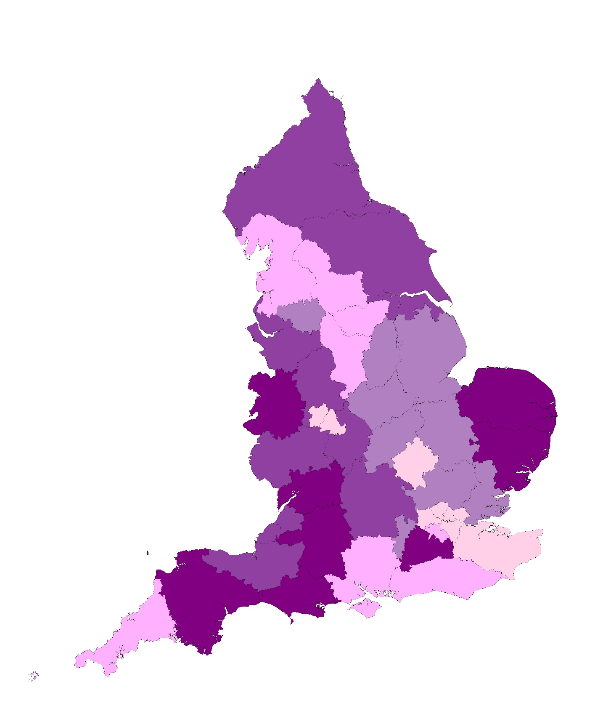
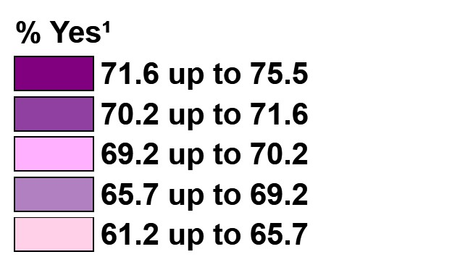
How did the support patients received to help manage their long-term condition or illness vary by Integrated Care Systems (ICSs)?
Support managing long-term conditions or illnesses
Q43. In the last 12 months, have you had enough support from local services or organisations to help you manage your conditions or illnesses?
The proportion of patients who felt that they had enough support¹ from local services or organisations to help them manage their condition or illness varied between ICSs (ranging from 61.2% to 75.5%, a difference of 14.3 percentage points).
ICS range - % Yes¹
Lowest
61.2%
Highest
75.5%
¹Yes = ‘yes, definitely’ and ‘yes, to some extent’
ICSs are divided into five equal sized groups based on their results; each group represents 20% of the ICSs. Base: asked of all patients with a long-term condition or illness, excluding those who said 'I haven't needed support' or 'I don't know': 2025 (337,532).
Main menu |

Slide 65
Did support received vary by type of long-term condition?
Q39. Which of the following long-term conditions or illnesses do you have?
Q43. In the last 12 months, have you had enough support from local services or organisations to help you manage your conditions or illnesses?
% Yes¹
Patients with cancer in the last five years were most likely to feel supported by local services or organisations to help manage their condition or illness (81.0%). This was followed by those with dementia or Alzheimer’s disease (76.2%), patients with diabetes (73.3%), high blood pressure (73.1%) stroke or TIA (Transient Ischemic Attack) (72.7%), or a heart condition (72.7%).
However, those with autism or an autism spectrum condition (50.5%), a learning disability (58.9%), or neurological condition (60.8%) were least likely to feel supported by local services or organisations.
²Note that patients may have multiple conditions and illnesses and may be reflecting on particular or multiple conditions or illnesses when answering this question.
¹Yes = ‘yes, definitely and ‘yes, to some extent’. Base: asked of patients with a long-term condition or illness, excluding those who said ‘I haven’t needed support’ and ‘I don’t know’: 2025 (336,452). Base range: Long-term condition or illness (4,077 to 143,362)
Main menu |

Slide 66
How were patients supported by healthcare professionals at their GP practice?
Over two in five patients (42.4%) with one or more long-term conditions or illnesses said they had a conversation with a healthcare professional from their GP practice to discuss what is important to them when managing their conditions or illnesses.
Of those who have had this conversation, more than two in five (44.9%) had agreed a plan, with the majority (93.4%) finding this plan helpful¹ in managing their conditions or illnesses. Since the last survey, there has been very little change in the proportion of patients who had agreed a plan and had found it helpful¹.
How patients were supported by healthcare professionals in managing their conditions or illnesses
Q44. Had a conversation with a healthcare professional to discuss what is important when managing their conditions or illnesses² | Q45. Of those who have had this conversation, those who had agreed a plan with a healthcare professional to manage their conditions or illnesses³ | Q46. Of those with a care plan, those who found it helpful¹ in managing their conditions or illnesses⁴
¹Helpful = ‘very helpful ’ and ‘fairly helpful’. ²Base: asked of all patients with a long-term condition or illness: 2025 (456,103), 2024 (430,262). ³Base: asked of patients who have had a conversation with a healthcare professional about managing their conditions or illnesses: 2025 (195,351), 2024 (179,938). ⁴Base: asked of patients who have agreed a plan to manage their conditions or illnesses, excluding those who said ‘I don’t know’: 2025 (85,765), 2024 (78,649)
Main menu |

Slide 67
When the GP practice is closed
Menu:
1
About the survey
Headline findings
Overall experience of GP practice
Local GP practice services
Last contact
Patient’s last appointment
Patient health
When the GP practice is closed
Pharmacy
Dentistry
Accessible information
8
2
3
4
5
6
7
9
10
11
Main menu

Slide 68
How did patients describe their overall experience of NHS services when their GP practice was closed?
Almost three in five (57.0%) patients had a good¹ overall experience of NHS services when they wanted care or advice from a healthcare professional in the last 12 months, but their GP practice was closed. One in five (20.8%) said their experience of NHS services when their GP practice was closed was poor², and another 22.1% described their experience as ‘neither good nor poor’.
Compared with the 2024 survey, there has been a slight increase in the proportion reporting a good¹ overall experience of NHS services when their GP practice was closed (+1.1 percentage points).
Q36. Overall, how would you describe your experience of NHS services on this occasion when your GP practice was closed?
¹Good = ‘very good’ or ‘fairly good’. ²Poor = ‘very poor’ or ‘fairly poor’. Base: asked of all patients: 2025 (193,580), 2024 (191,189).
Main menu |

Slide 69
Have patients contacted an NHS service when their GP practice was closed?
Q34. Which of the following services did you contact or use on that occasion? (multiple responses allowed)
Three in ten patients (31.0%) had tried to contact or use an NHS service in the last 12 months when they wanted care or advice from a healthcare professional at their GP practice, but it was closed¹.
23.0% had done this for themselves and 11.2% for someone else.
Patients who contacted an NHS service when their GP practice was closed
Of these patients, 44.9% phoned NHS 111, 23.4% went to A&E and 17.0% went to a pharmacy. Over one in ten went to an urgent treatment centre (12.8%) or used NHS 111 online (11.7%).
All patients
When analysing these results based on all patients responding to the survey, 13.6% phoned NHS 111, 7.1% went to A&E, and 5.2% went to a pharmacy when their GP practice was closed.
¹Tried to contact or use an NHS service = ‘yes, for myself’ and/ or ‘yes, for someone else. Base: asked of all patients: 2025 (695,857).
²Base: Asked of patients who contacted or used an NHS service in the last 12 months when they wanted care or advice from a healthcare professional at their GP practice but it was closed: 2025 (193,102). ³Base: all patients completing a questionnaire: 2025 (702,837).
Main menu |

Slide 70
How did patients feel about how quickly they received care or advice when their GP practice was closed?
Q35. How do you feel about how long you waited to get care or advice on that occasion?
Just over half (52.3%) of patients said the time they waited to get care or advice when their GP practice was closed was ‘about right’. Just under half (47.7%) said ‘it took too long’.
Compared with the 2024 survey, a higher proportion said the wait was ‘about right’ (+2.1 percentage points).
Base: asked of patients who contacted or used an NHS service in the last 12 months when they wanted care or advice from a healthcare professional at their GP practice but it was closed, excluding those who said 'I don't know or it doesn't apply': 2025 (176,089), 2024 (173,854).
Main menu |

Slide 71
Pharmacy
Menu:
1
About the survey
Headline findings
Overall experience of GP practice
Local GP practice services
Last contact
Patient’s last appointment
Patient health
When the GP practice is closed
Pharmacy
Dentistry
Accessible information
9
2
3
4
5
6
7
8
10
11
Main menu

Slide 72
How did patients describe their experience of using pharmacy services?
Nearly nine in ten (88.0%) patients said they had a good¹ experience of the pharmacy services they had used in the last 12 months, including over half (51.6%) who said their experience was ‘very good’. Fewer than four percent (3.8%) said their experience was poor, and another 8.2% said it was ‘neither good nor poor’.
Compared with the 2024 survey, there has been a slight increase in the proportion reporting a good¹ overall experience of pharmacy services (+1.2 percentage points).
Q48. How would you describe your experience of using these pharmacy services?
¹Good = ‘very good’ or ‘fairly good’. ²Poor = ‘very poor’ or ‘fairly poor’. Base: asked of all patients who have used a pharmacy for one of the services named in Q47 in the last 12 months: 2025 (631,337), 2024 (625,567).
Main menu |

Slide 73
Which pharmacy services have patients used in the last 12 months?
Q47. Thinking about the last 12 months, which of the following services have you used a pharmacy for? (multiple responses allowed)
Overall, 87.9% reported using at least one of the listed pharmacy services in the 12 months before taking part in the survey¹.
Patients most commonly reported picking up prescriptions (75.3%) or buying medication (44.0%).
Around one in five said they had used pharmacy services to get advice (22.3%) or for a vaccine (18.7%).
Eight percent (8.4%) reported using a pharmacy because they were referred there by their GP practice, NHS 111 or A&E, 7.0% had their blood pressure checked and 2.9% said they had their medication monitored or received other support for a long-term health condition.
1.7% had used the pharmacy to get contraception without a GP prescription.
Just over one in ten (12.1%) reported not using any of the pharmacy services listed in the 12 months before taking part in the survey.
Overall these findings are similar to the 2024 survey, but slightly more had used a pharmacy to get advice, because they were referred by another service or to have their blood pressure checked.
¹Used any pharmacy service = ‘to pick up a prescription’ or ‘to buy medication (such as paracetamol or eye)’ or ‘to get advice (for example, about prescription medicines, a health issue or other health services)’ or ‘to get a vaccine (for example, flu or COVID)’ or ‘to address an issue which my GP practice, NHS 111 or A&E referred me to a pharmacy for’ or ‘to have my blood pressure checked’ or ‘to monitor my medication or get other support for a long-term health condition’ or ‘to get contraception without a GP prescription’. Base: asked of all patients: 2025 (689,984). 2024 (694,064).
Main menu |

Slide 74
Dentistry
Menu
1
About the survey
Headline findings
Overall experience of GP practice
Local GP practice services
Last contact
Patient’s last appointment
Patient health
When the GP practice is closed
Pharmacy
Dentistry
Accessible information
10
2
3
4
5
6
7
8
9
11
Main menu

Slide 75
How did patients describe their overall experience of NHS dental services?
Seven in ten (70.8%) patients said they had a good¹ overall experience of NHS dental services, including 42.0% who said their experience was ‘very good’. Just over one in six (17.9%) said their experience was poor², and 11.3% said it was ‘neither good nor poor’.
Compared with the 2024 survey, there has been an increase in the proportion reporting a good¹ overall experience of NHS dental services (+1.6 percentage points).
Q52. Overall, how would you describe your experience of NHS dental services?
¹Good = ‘very good’ or ‘fairly good’. ²Poor = ‘very poor’ or ‘fairly poor’. Base: asked of patients who have tried to get an NHS dental appointment in the last two years. Patients who selected 'I can't remember' have been excluded: 2025 (368,026), 2024 (370,796).
Main menu |

Slide 76
When did patients last try to get an NHS dental appointment?
Q49. When did you last try to get an NHS dental appointment for yourself?
Overall, 51.2% had tried to get an NHS dental appointment in the last 2 years¹, including one in five (19.9%) who had tried in the last 3 months.
One in five (19.8%) reported it was more than two years ago since they had last tried to get an NHS dental appointment.
Three in ten (29.0%) said they had never tried to get one, an increase of 1.4 percentage points compared with the 2024 survey (27.6%).
¹In the last 2 years = ‘in the last 3 months’ or ‘between 3 and 6 months ago’ or ‘between 6 months and a year ago’ or ‘between 1 and 2 years ago’. Base: asked of all patients: 2025 (697,155), 2024 (688,941).
Main menu |

Slide 77
The last time patients tried to get a dental appointment, was it with a dental practice they had been to before for NHS dental care?
Q50. Last time you tried to get an NHS dental appointment, was it with a dental practice you had been to before for NHS dental care?
Of those who tried to get an NHS dental appointment in the last two years, more than four in five (84.0%) said this was with a dental practice they had been to before for NHS dental care.
This is in line with the 2024 survey findings.
Base: asked of patients who have tried to get an NHS dental appointment in the last two years, excluding those who said ‘I can’t remember': 2025 (355,648), 2024 (359,430).
Main menu |

Slide 78
Were patients able to get an NHS dental appointment?
Q51. Were you able to get an NHS dental appointment? (multiple responses allowed)
Over three quarters (78.2%) of patients who had tried to get an NHS dental appointment in the last two years said they were able to get one. This is a 1.9 percentage point increase compared with the 2024 survey (previously 76.3%).
Just under a quarter (24.5%) said they were not able to get an NHS dental appointment¹, including 10.5% who said the dentist was ‘not taking new patients’, 8.6% that there were ‘no appointments available’ and 5.4% for ‘another reason’.
¹No = ‘no, no appointments were available’ or ‘no, the dentist was not taking new patients’ or ‘no, for another reason’. Base: asked of patients who have tried to get an NHS dental appointment in the last two years, excluding those who said ‘I can’t remember': 2025 (358,869), 2024 (362,092).
Main menu |

Slide 79
Why have patients not tried to get an NHS dental appointment in the last two years?
Q53. Why haven’t you tried to get an NHS dental appointment in the last two years?
Just under half (48.8%) have not tried to get an NHS dental appointment in the last two years.
Of these, 26.7% said this was because they preferred to go to a private dentist and 26.2% said they did not think they could get an NHS dental appointment. Just under one in five (18.8%) said they had not needed to visit a dentist.
Other reasons were given by fewer, including finding NHS dental care too expensive (5.6%) or not liking the dentist (5.2%). Four percent (3.9%) said that they were on a waiting list for an NHS dentist.
One in seven (13.7%) said they had another reason for not trying to get an NHS dental appointment in the last two years.
These findings are very similar to results in 2024, although a slightly higher proportion said they didn’t think they could get an NHS dental appointment (+1.5 percentage points).
Base: asked of patients who have not tried to get an NHS dental appointment in the last two years: 2025 (320,842), 2024 (307,659).
Main menu |

Slide 80
Accessible information
Menu:
1
About the survey
Headline findings
Overall experience of GP practice
Local GP practice services
Last contact
Patient’s last appointment
Patient health
When the GP practice is closed
Pharmacy
Dentistry
Accessible information
11
2
3
4
5
6
7
8
9
10
Main menu

Slide 81






Accessible information
Questions about communication and getting information in a way that patients understand, which reflect the NHS Accessible Information Standard, were included for the first time in the 2025 survey.
Due to space constraints in the paper questionnaire, these questions were only asked of patients who responded to the survey online, or via an accessible format (including by telephone or large print). An alternative weight is used to account for this.
Results at ICS level can be found in the ICS level Excel tables, available on the surveys and reports page of the GPPS website.
The inclusion of online-only questions is a new development for GPPS. As such, these results are labelled as official statistics in development, in line with the standards of trustworthiness, quality, and value in the Code of Practice for Statistics.
Please share any feedback on the online-only questions with GPPatientSurvey@ipsos.com.
Easy read
Audio
British Sign Language
Letter, email or text
Large print
Braille
Main menu |

Slide 82
Around one in ten patients (9.1%) say they find it difficult to see, hear, speak, read or understand what is being said to them.
Have these patients been asked by their practice how they would prefer to be given information or communicate?
Patients who said that they found it difficult to see, hear, speak, read or understand what is being said were asked about their experience of communication with their GP practice. ​
Around one in five (21.0%) said they had been asked by someone who works at their GP practice about how they prefer to be given information or communicate, 66.1% said they had not, another 12.9% could not remember.
Q65. Do you find it difficult to see, hear, speak, read or understand what is being said to you?
Q66. Have you been asked by someone who works at your GP practice about how you prefer to be given information or communicate?
Base: Asked of all patients who said they find it difficult to see, hear, speak, read or understand what is being said: 2025 (54,945)
Official statistic in development - These questions were only asked of patients who responded to the survey online, or via an accessible format, and use an alternative weight to account for this.
Base: Asked of all patients taking part online, or via an accessible format: 2025 (584,722)

Slide 83
Did practices who asked about preferences, make a record in the patient’s medical notes of how they want to be given information or communicate?
How often did patients who had been asked about preferences get help from staff at their GP practice to communicate and understand information they have been given?
Three in five (63.5%) said they get the help they want from staff at their GP practice to communicate and understand the information they have been given always or almost always or a lot of the time¹. Just over a third (36.5%) said they get it some of the time or never².
Around half (49.2%) said their GP or practice made a record in their medical notes of how they want to be given information or communicate.
Around one in seven (13.8%) said their GP or practice had not made a record in their medical notes, and 37.0% said they did not know.
Q68. How often do you get the help you want from staff at your GP practice to communicate and understand the information you are given?
Q67. Did your GP or practice make a record in your medical notes of how you want to be given information or communicate?
¹Always, almost always or a lot of the time = ‘Always or almost always’ + ‘a lot of the time’. ² Some of the time or never = ‘Some of the time’ + ‘never or almost never’ Base: Asked of all patients who said they find it difficult to see, hear, speak, read or understand what is being said and who have been asked about how they prefer to be given information or communicate. Patients who selected 'I can't remember' have been excluded: 2025 (10,515).
Official statistic in development - These questions were only asked of patients who responded to the survey online, or via an accessible format, and use an alternative weight to account for this.
Base: Asked of all patients who said they find it difficult to see, hear, speak, read or understand what is being said and who have been asked about how they prefer to be given information or communicate 2025 (11,380).

Slide 84
Overall experience of last contact with GP practice, for patients who say that they find it difficult to see, hear, speak, read or understand what is being said to them
Q16. Overall, how would you describe your experience of contacting your GP practice on this occasion?
% Good¹
Do you find it difficult to see, hear, speak, read or understand what is being said to you?
Patients who find it difficult to see, hear, speak, read or understand what is being said to them were less likely to say their last contact was good¹ (65.5%) than those who do not find it difficult (70.9%).
Have you been asked by someone who works at your GP practice about how you prefer to be given information or communicate?
Among those who find it difficult to see, hear, speak, read or understand what is being said to them, patients who have been asked how they prefer to be given information or communicate were more likely to say their last contact was good¹ (75.6%) than those who had not been asked about their preferences (61.7%) or could not remember (68.5%) if they had been asked.
Q65. Do you find it difficult to see, hear, speak, read or understand what is being said to you?
% Good¹
Q66. Have you been asked by someone who works at your GP practice about how you prefer to be given information or communicate?
(only asked of those who said ‘yes’ at Q65)
% Good¹
¹Good = ‘very good’ and ‘fairly good’. Base: asked of patients who have tried to contact their GP practice since being registered: 2025 (686,100). Base ranges: Q65 Do you find it difficult to see, hear, speak, read or understand what is being said to you? (9,318 to 501,366), Q66 Have you been asked by someone who works at your GP practice about how you prefer to be given information or communicate? (6,199 to 36,752)
Official statistic in development – Q65 and Q66 were only asked of patients who responded to the survey online, or via an accessible format, and use an alternative weight to account for this.
Main menu |

Slide 85
For more information:
For more information on the survey methodology, go to https://gp-patient.co.uk/surveysandreports - you can also find the 2025 Technical Annex on the website
For reports showing the national results broken down by ICS, PCN and practice, go to https://www.gp-patient.co.uk/surveysandreports - you can also see previous years’ results here
To analyse the survey data for a specific participant group (e.g. by age), go to https://gp-patient.co.uk/analysistool
To break down the survey results by survey question as well as by participant demographics, go to https://gp-patient.co.uk/analysistool
For frequently asked questions (FAQs) about the GP Patient Survey, go to https://www.gp-patient.co.uk/faq

